Slide 1
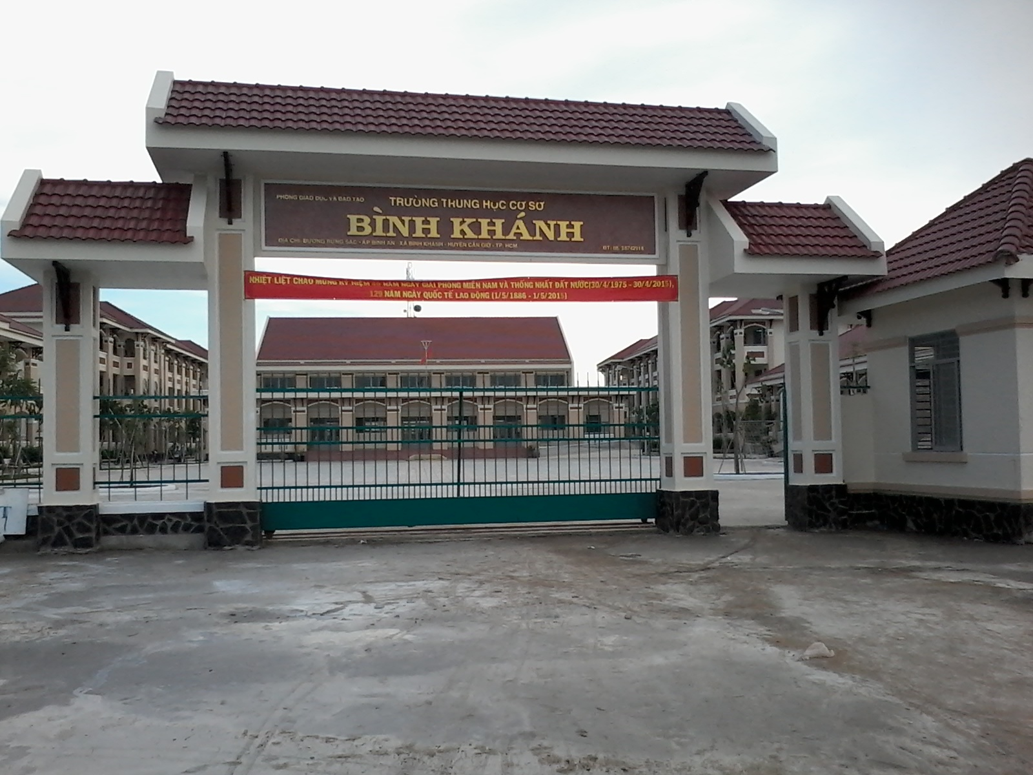
BINH KHANH SECONDARY SCHOOL
ENGLISH 8

Slide 2
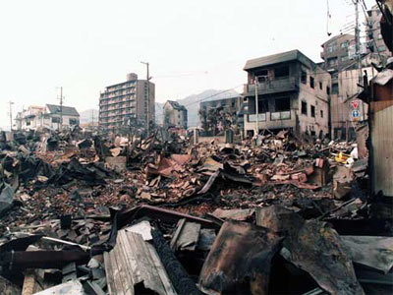
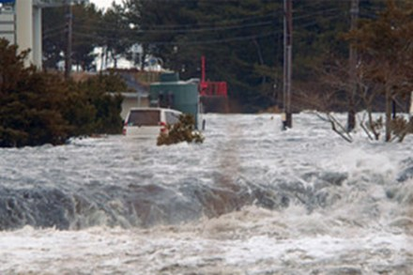
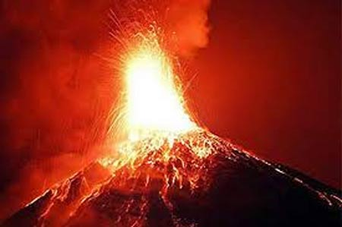
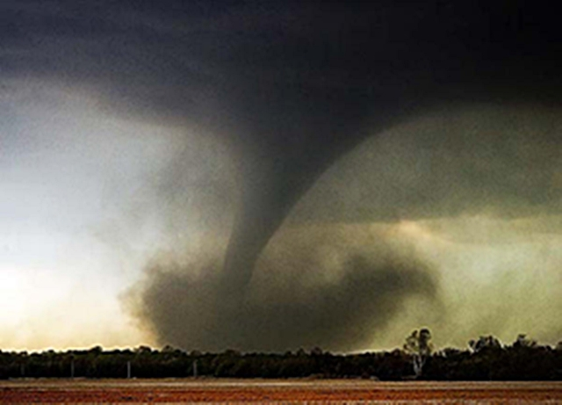
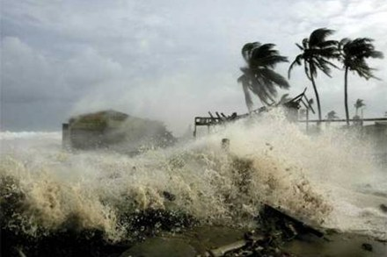
Match the pictures with names of natural disaster.
1. Tidal wave
2. Earthquake
3. Typhoon
4. Volcano
5. Tornado
B
A
D
E
C

Slide 3
UNIT 9: NATURAL DISASTERS Lesson 4: Read P.78 - 79
New words
- erupt (v)
eruption (n):
phun trào
- abrupt shift (n):
sự thay đổi đột ngột
- Collapse (v):
sụp, đổ
- funnel-shaped (a):
hình cái phễu
- warn (v):
báo trước

Slide 4
Matching
1. occur
2. abrupt shift
3. erupt
4. Pacific Rim
5. damage
6. funnel-sharped
7. warn
8. collapse
hư hỏng
vành đai Thái Bình Dương
xảy ra
hình cái phễu
sự thay đổi đột ngột
báo trước
sụp, đổ
phun trào
1c
2e 3h 4b 5a 6d 7f 8g

Slide 5
There are five natural disasters which are mentioned in the text. What are they?

Slide 6
True/ False Prediction
1.Most of the earthquakes in the world occur in the Ring of Fire.
2. The earthquake in Kobe in 1995 caused several damage.
3. A huge tidal wave traveled from California to Alaska and hit Anchorage in the 1960s.
4. Typhoon, hurricane and tropical storm are different words for the same natural disaster.
5. The eruption of Mount Pinatubo is the world’s largest ever volcanic eruption.
6. A tornado looks like a funnel.

Slide 7
True / False Correction
1.Most of the earthquakes in the world occur in the Ring of Fire.
2. The earthquake in Kobe in 1995 caused several damage.
3. A huge tidal wave traveled from California to Alaska and hit Anchorage in the 1960s.
4. Typhoon, hurricane and tropical storm are different words for the same natural disaster.
5. The eruption of Mount Pinatubo is the world’s largest ever volcanic eruption.
6. A tornado looks like a funnel.
True
True
False
Alaska to California
True
False
over 50 years
True

Slide 8
Read again. Then complete the sentences with the best option.
1.The majority of earthquakes ……….in the Pacific Rim.
A. occur B. come C. arrive D. both A & B
2. During the earthquake in Kobe, many people were killed when home and highway……………..
A. collapse B. collapsed C. collapsing D. to collapse
3. A tidal wave can only occur when there is………shift in the underwater movement of the Earth.
A. Erupt B. pour C. abrupt D. reach
4. In Australia, a tropical storm is known as……….
A. Hurricane B. typhoon C. thunderstorm D. cyclone
5. The ………. language gave us the word Typhoon
A. Chinese B. Vietnamese C. Japanese D. cheese
6. A …is a type of storm that passes overland below a thunderstorm.
A. Volcano B. tornado C. tidal wave D. cyclone

Slide 9
Discuss in pairs.
1. Typhoon sometimes occurs in Viet Nam nowadays. What do you prepare for a typhoon ?
- …………
- …………

Slide 10
Homework
Write-it-up.
Learn new words by heart.
Prepare lesson 5: write P.79-80

